Slide 1
Laplace Transform and Solutions of Passive Electrical Networks
Compiled By:
Asst. Prof. Uddhav Bhattarai
Cosmos College of Management and Technology

Slide 2
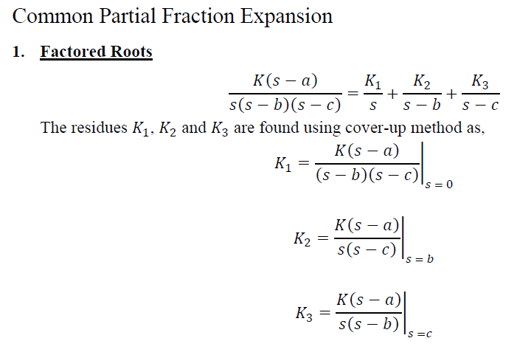
Laplace Transform and Solutions of Passive Electrical Networks

Slide 3
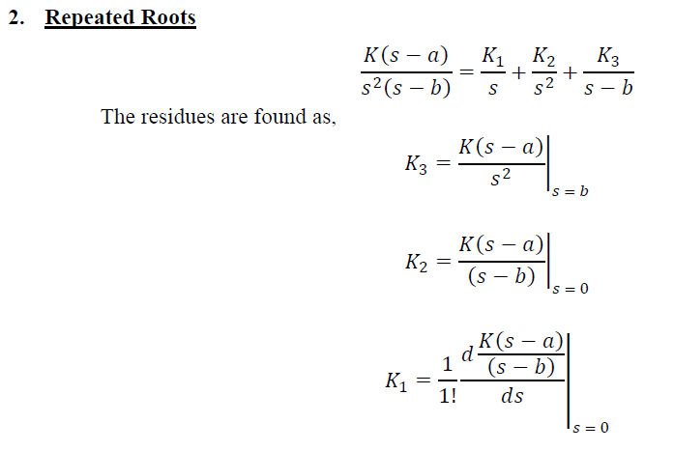
Laplace Transform and Solutions of Passive Electrical Networks

Slide 4
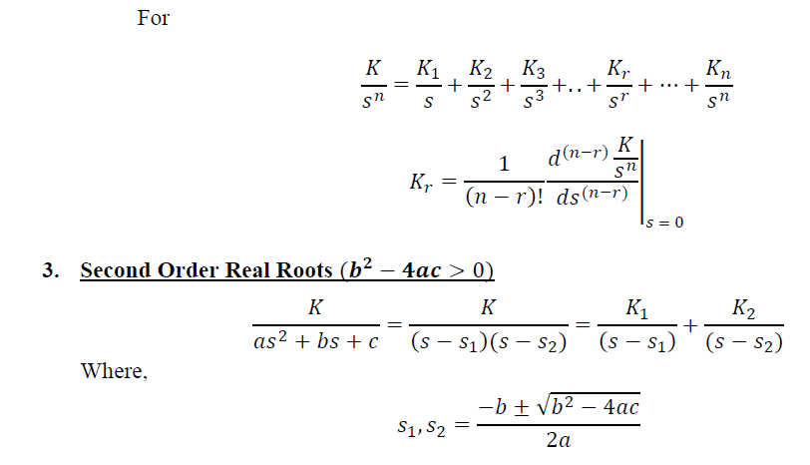
Laplace Transform and Solutions of Passive Electrical Networks

Slide 5
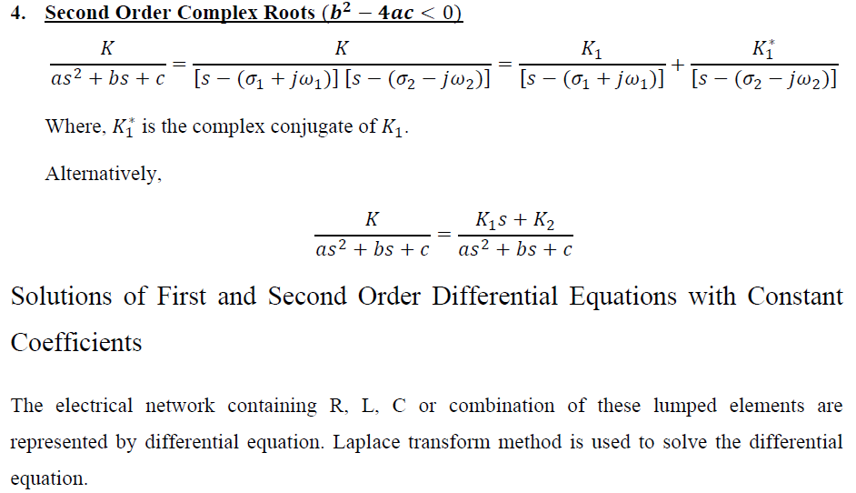
Laplace Transform and Solutions of Passive Electrical Networks

Slide 6
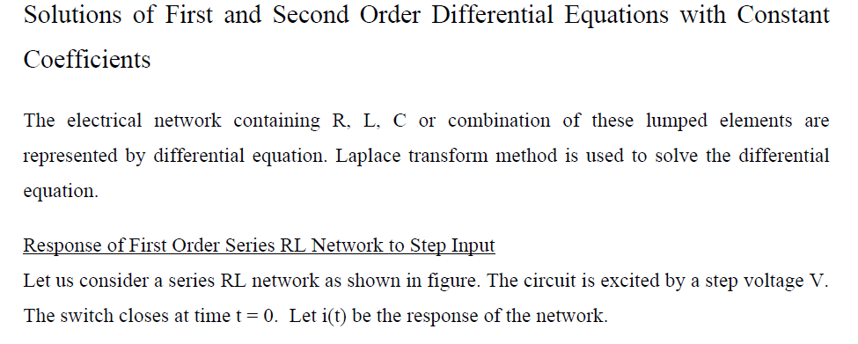
Laplace Transform and Solutions of Passive Electrical Networks

Slide 7
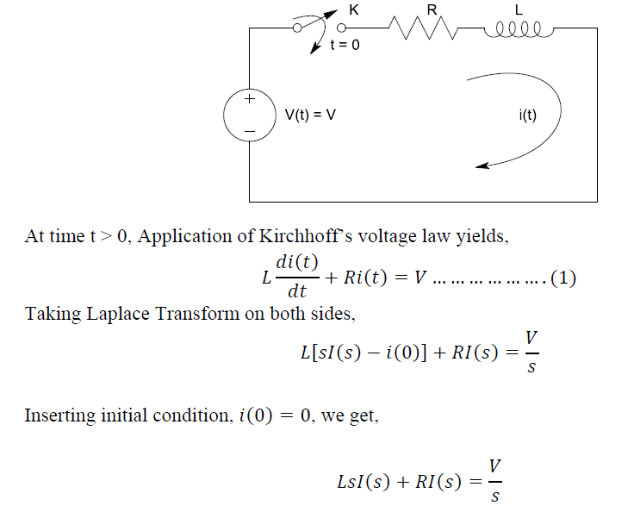
Laplace Transform and Solutions of Passive Electrical Networks

Slide 8
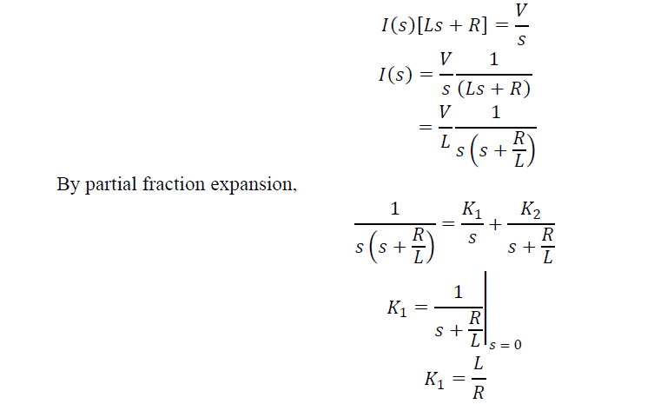
Laplace Transform and Solutions of Passive Electrical Networks

Slide 9
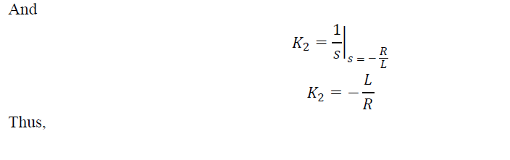
Laplace Transform and Solutions of Passive Electrical Networks

Slide 10
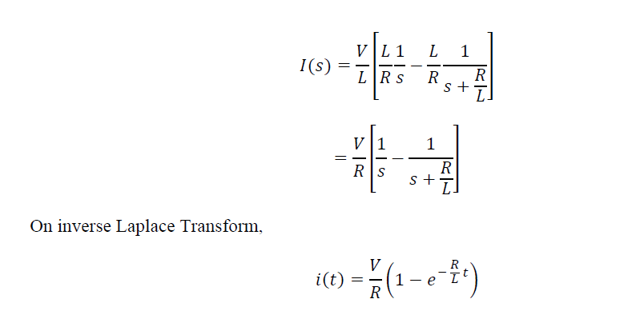
Laplace Transform and Solutions of Passive Electrical Networks

Slide 11
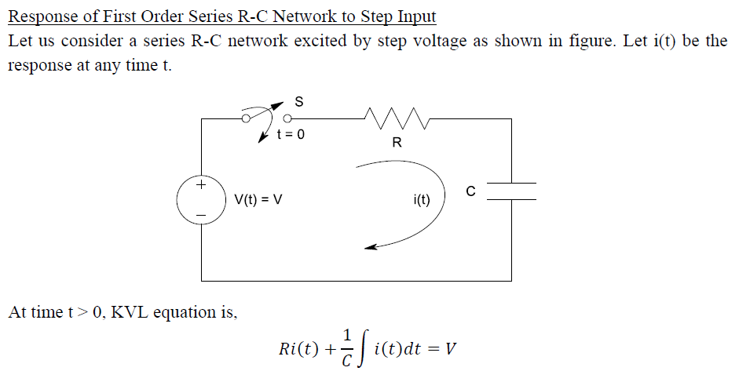
Laplace Transform and Solutions of Passive Electrical Networks

Slide 12
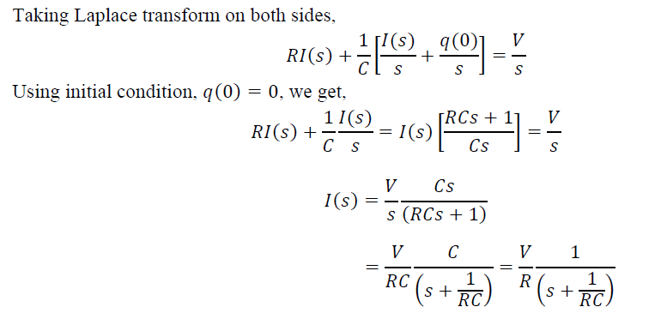
Laplace Transform and Solutions of Passive Electrical Networks

Slide 13
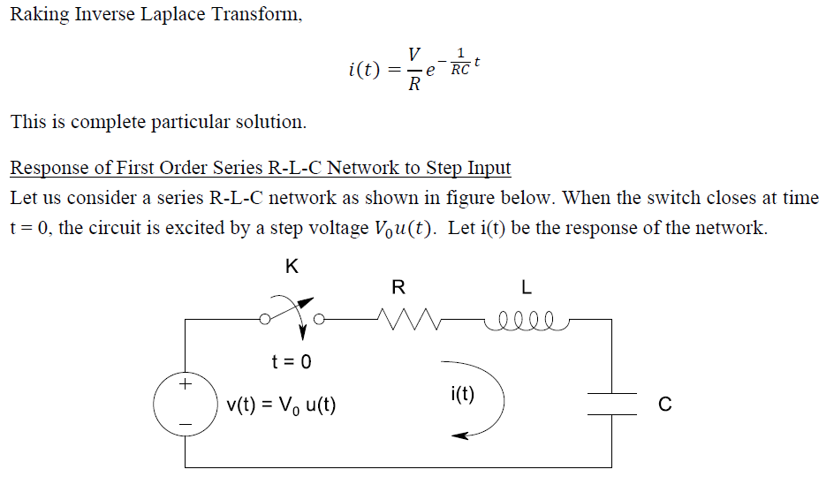
Laplace Transform and Solutions of Passive Electrical Networks

Slide 14
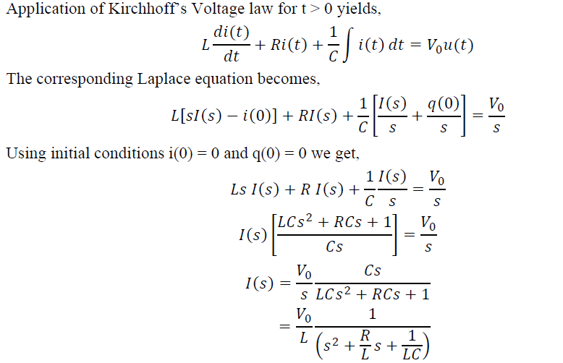
Laplace Transform and Solutions of Passive Electrical Networks

Slide 15
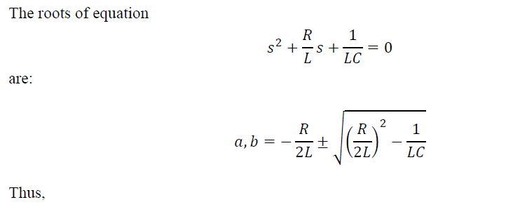
Laplace Transform and Solutions of Passive Electrical Networks

Slide 16
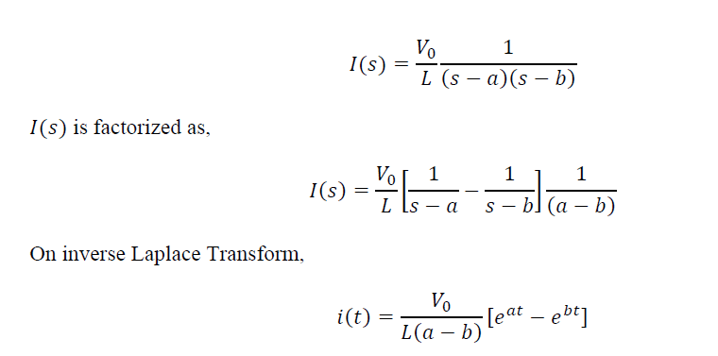
Laplace Transform and Solutions of Passive Electrical Networks

Slide 17
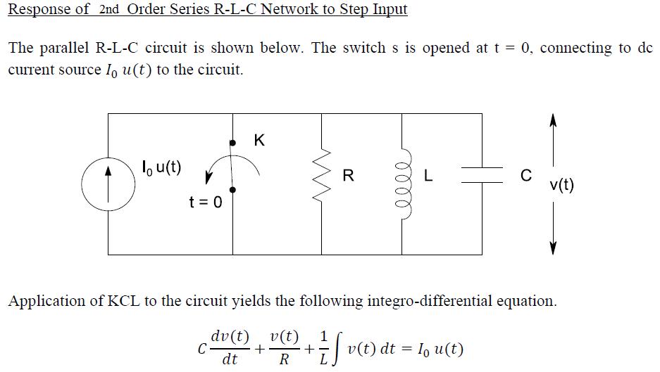
Laplace Transform and Solutions of Passive Electrical Networks

Slide 18
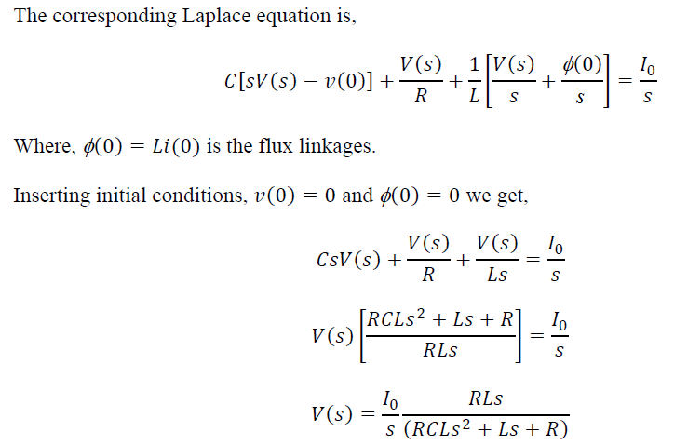
Laplace Transform and Solutions of Passive Electrical Networks

Slide 19
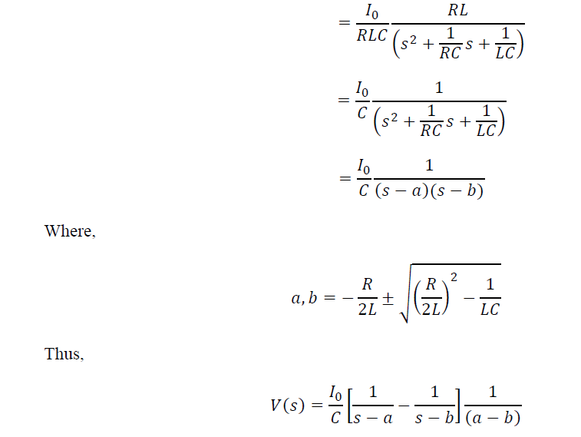
Laplace Transform and Solutions of Passive Electrical Networks

Slide 20
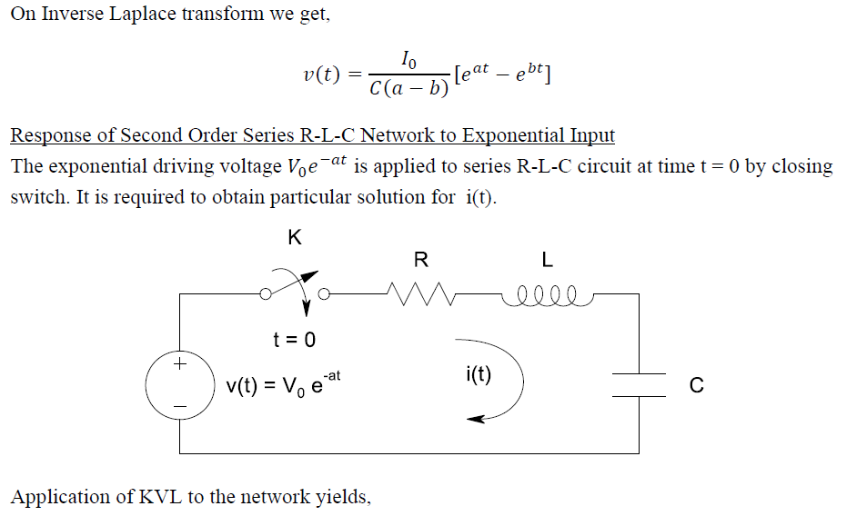
Laplace Transform and Solutions of Passive Electrical Networks

Slide 21
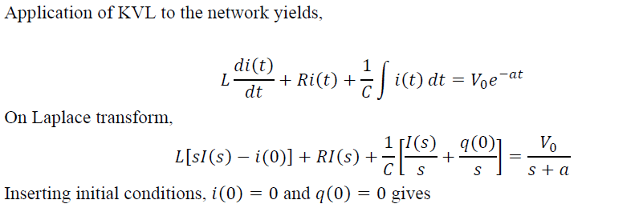
Laplace Transform and Solutions of Passive Electrical Networks

Slide 22
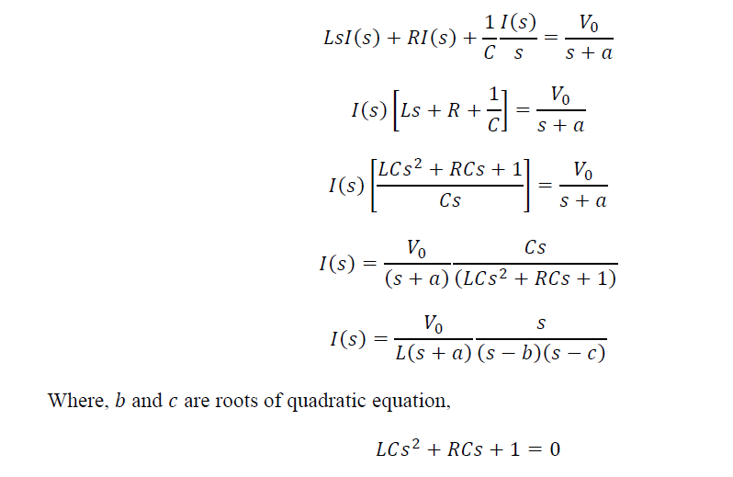
Laplace Transform and Solutions of Passive Electrical Networks

Slide 23
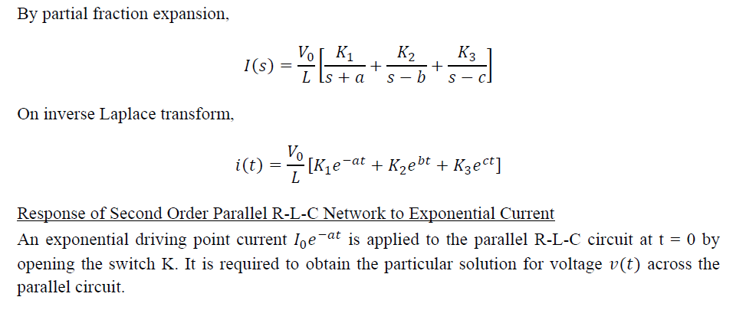
Laplace Transform and Solutions of Passive Electrical Networks

Slide 24
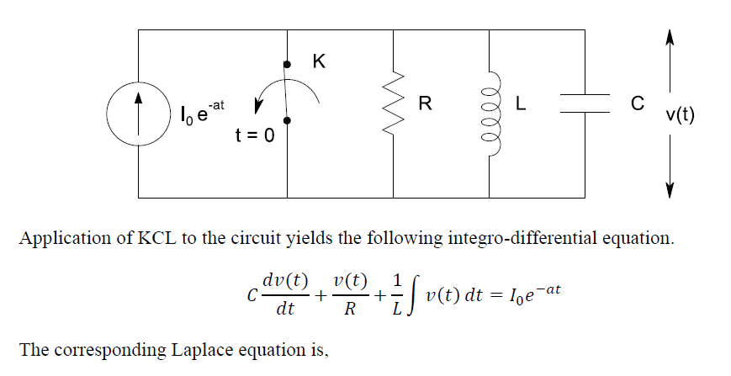
Laplace Transform and Solutions of Passive Electrical Networks

Slide 25
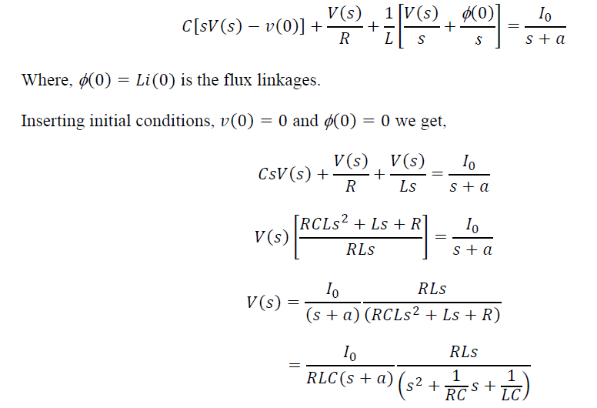
Laplace Transform and Solutions of Passive Electrical Networks

Slide 26
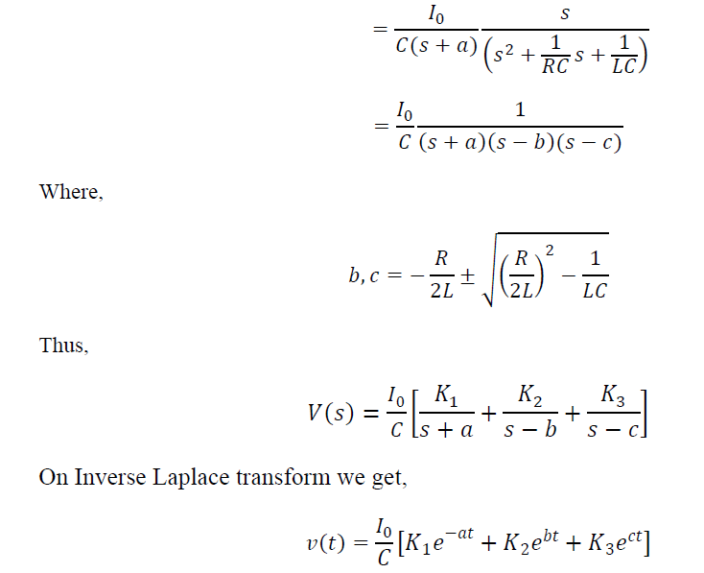
Laplace Transform and Solutions of Passive Electrical Networks

Slide 27
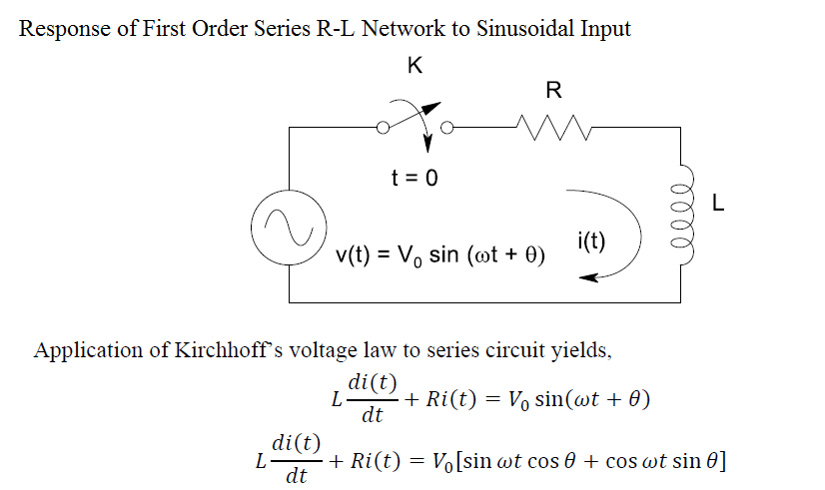
Laplace Transform and Solutions of Passive Electrical Networks

Slide 28
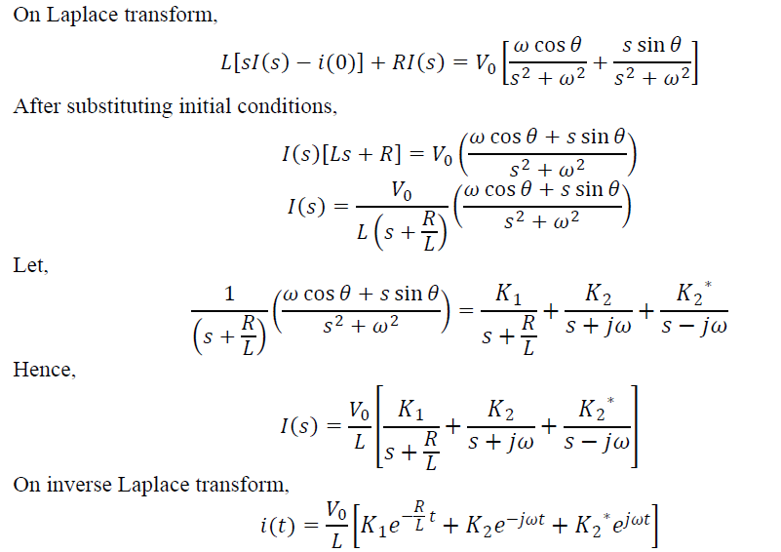
Laplace Transform and Solutions of Passive Electrical Networks

Slide 29
Laplace Transform and Solutions of Passive Electrical Networks
Thank You!!!

